Slide 1
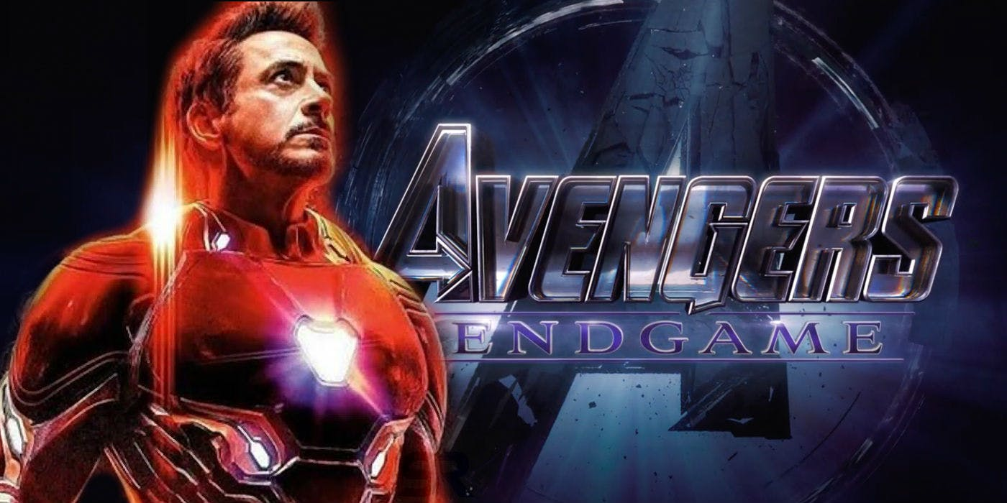
From End Game to Dev.
From End Game to Dev.

Slide 2
产品开发 - Charter
Start
Charter (TR1)
Scrum Iterators
SD (TR3)
Sprint
SD Revising
ST (TR4)
Scrum Iterators
Release (TR5)
LMT

Slide 3

Half of all life were destroyed

Slide 4
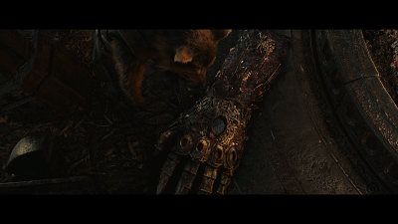
Infinity stones were destroyed, too

Slide 5
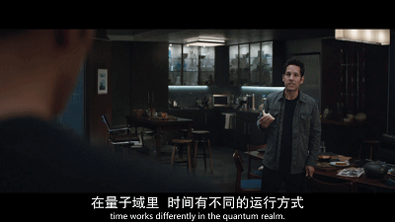
Ant man raised an story to fix this problem

Slide 6
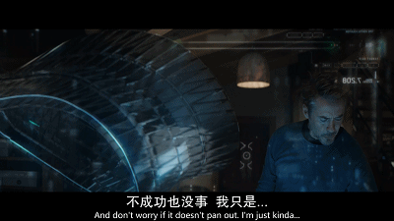
Iron man checked the feasibility of its key technology

Slide 7

The Avengers team was created for Time Heist Project

Slide 8
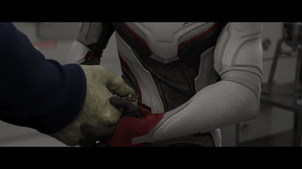
The top risks were addressed as far as they knew

Slide 9
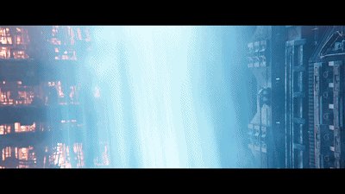
But, there is no competition analysis…

Slide 10
Charter [需求分析,立项报告,可行性研究报告]
Charter
评审会 (TR1)
问题和挑战
竞争分析
里程碑计划
指定产品经理
价值创造
核心技术方案
团队分工
交付指标
风险管理
成本

Slide 11
产品开发 – System Design
Start
Charter (TR1)
Scrum Iterators
SD (TR3)
Sprint
SD Revising
ST (TR4)
Scrum Iterators
Release (TR5)
LMT

Slide 12
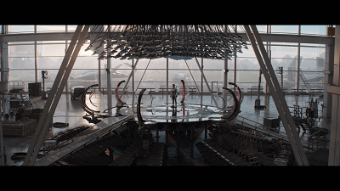
Key technical concepts verification

Slide 13
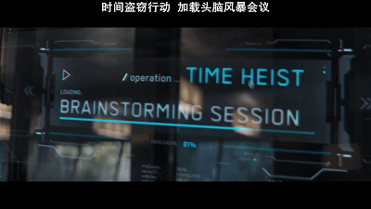
Brain storming…

Slide 14
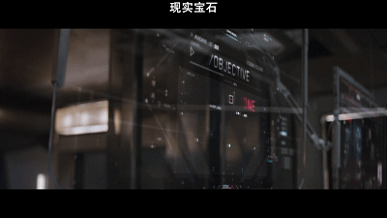
Objective discussion and design…

Slide 15
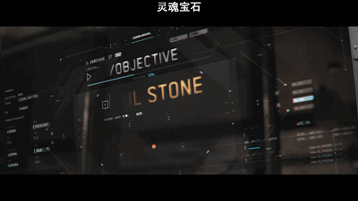
Objective discussion and design…

Slide 16
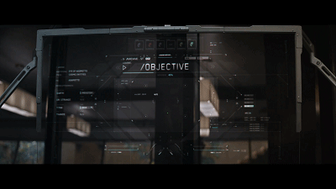
Objective discussion and design…

Slide 17
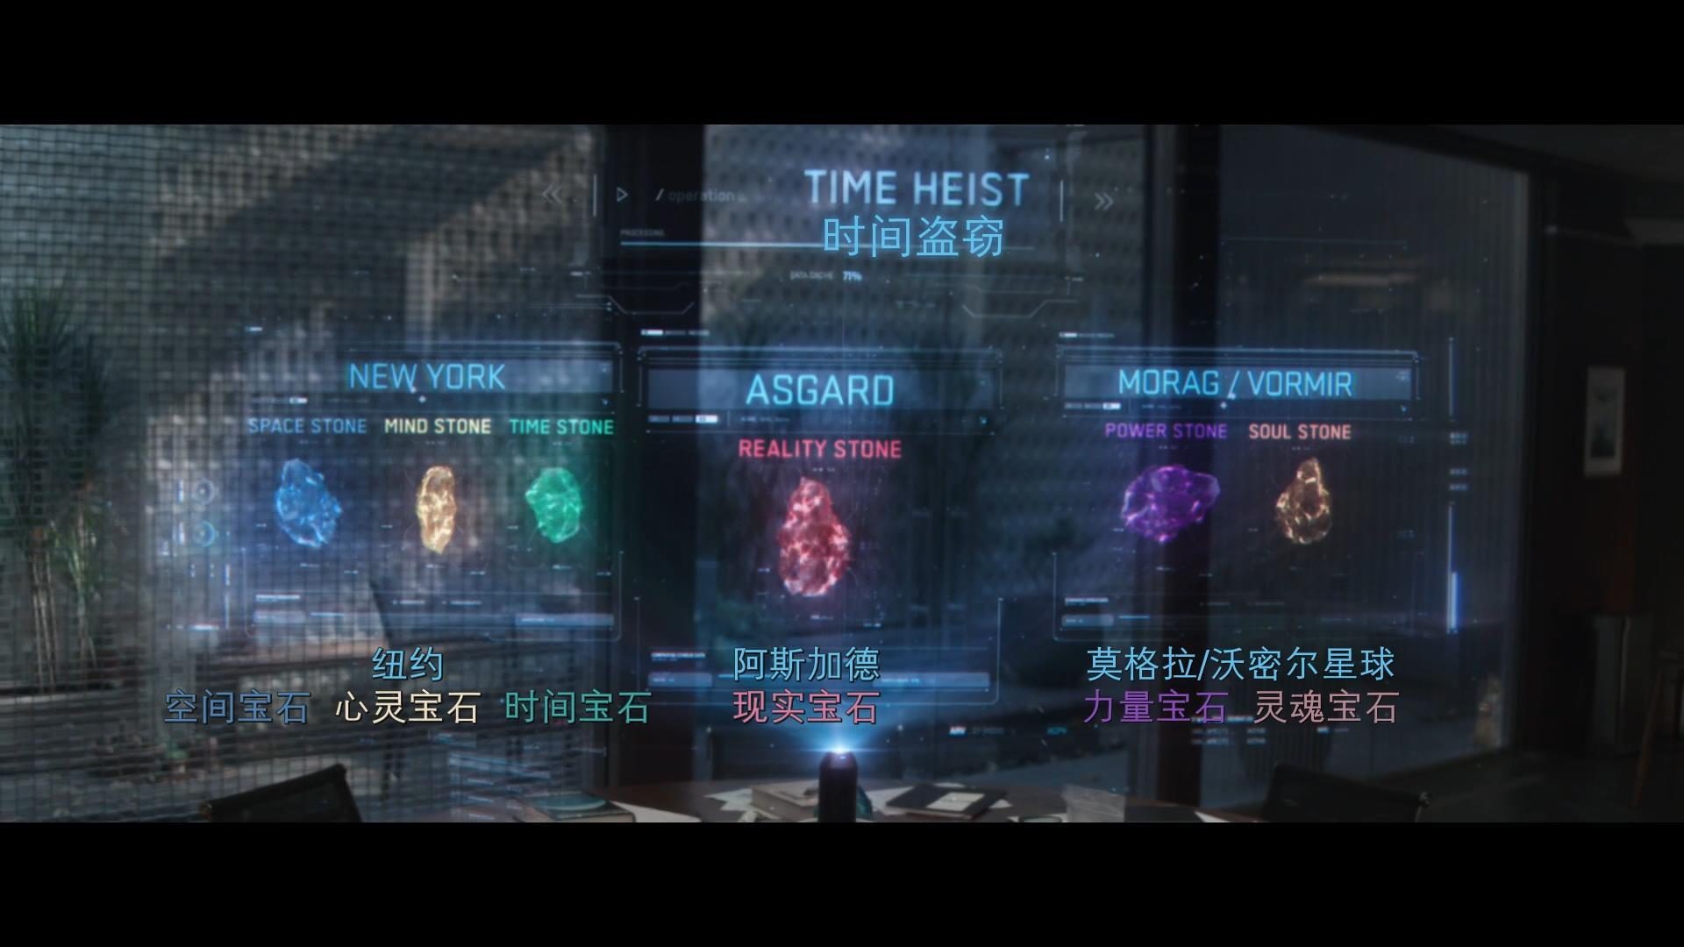
Data design…

Slide 18
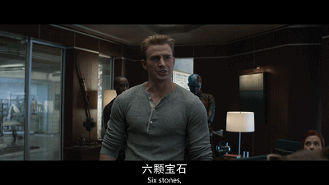
Flowchart and distribution design…

Slide 19
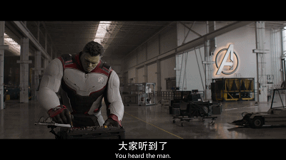
Interface design…

Slide 20
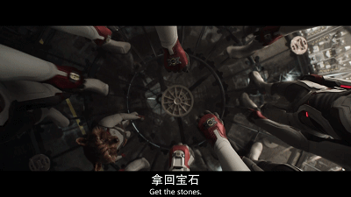
Poor risk management

Slide 21
SD [系统设计]
业务/技术都参与
System Design
评审会 (TR3)
核心技术方案
数据设计
子系统流程
接口设计
风险管理
子系统部署
界面设计

Slide 22
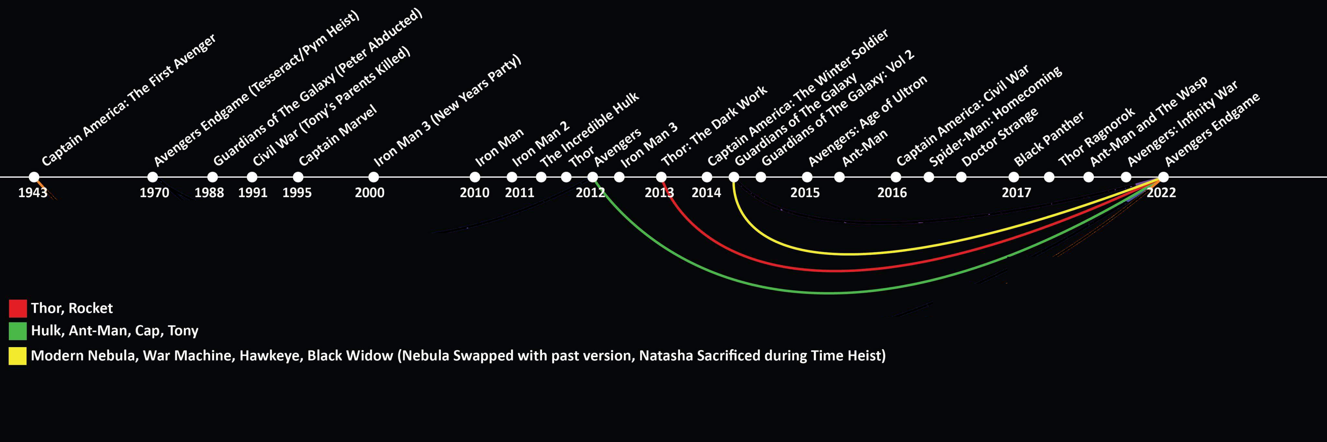
SD [系统设计]

Slide 23
SD [系统设计] – 工具：word，ppt都行
最少的文字，标准化的图表去定义想象中的系统
Draw.io
Flowcharts模版

Slide 24
产品开发 – Sprints
Start
Charter (TR1)
Scrum Iterators
SD (TR3)
Sprint
SD Revising
ST (TR4)
Scrum Iterators
Release (TR5)
LMT

Slide 25
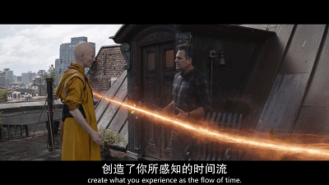
Force majeure…

Slide 26

Pig team member…

Slide 27
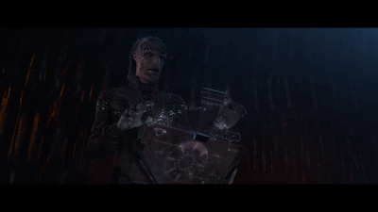
Ignored risks…

Slide 28
SD [系统设计] – 基线

Slide 29
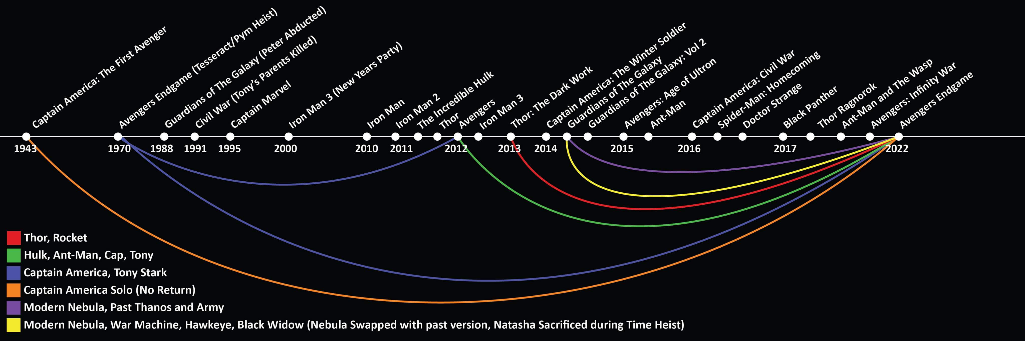
SD [系统设计] – 变更

Slide 30
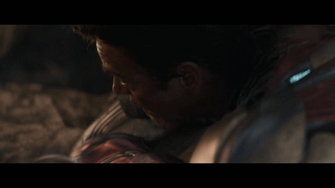
God’s perspective right here looking at you

Slide 31
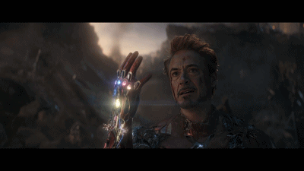
Happy ending with some regrets…

Slide 32

联系方式
13911132361
liheng19@mails.Tsinghua.edu.cn

